Slide 1


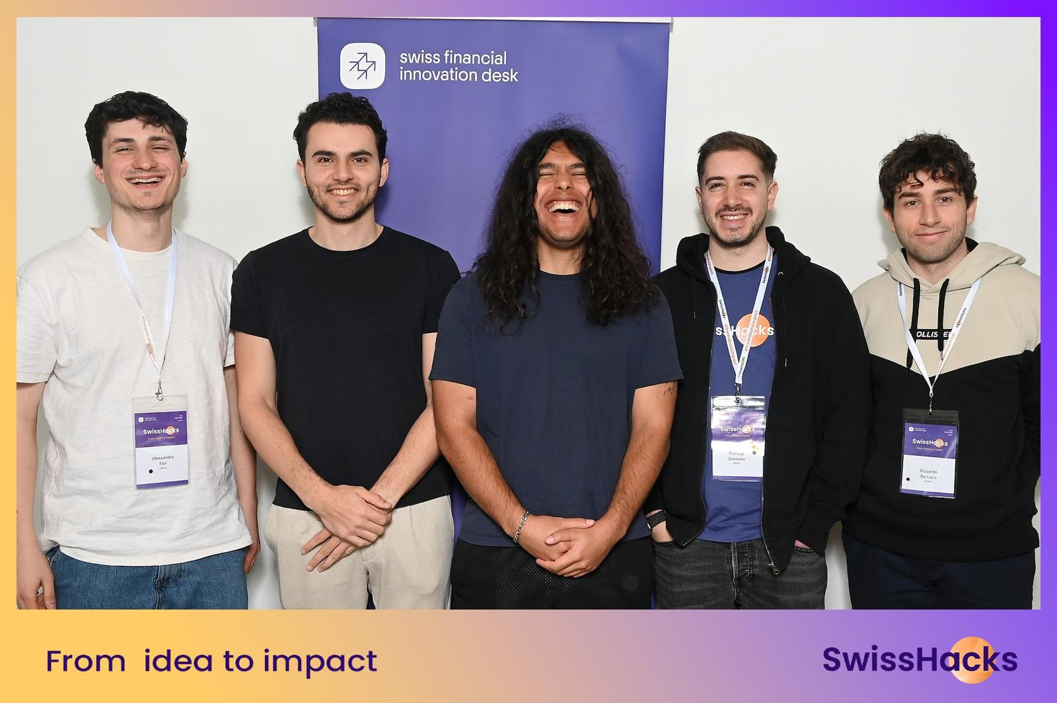
SmartAdvisor
team picture
Raiffeisen: Augmenting Advisors using real-time data and client history

Slide 2
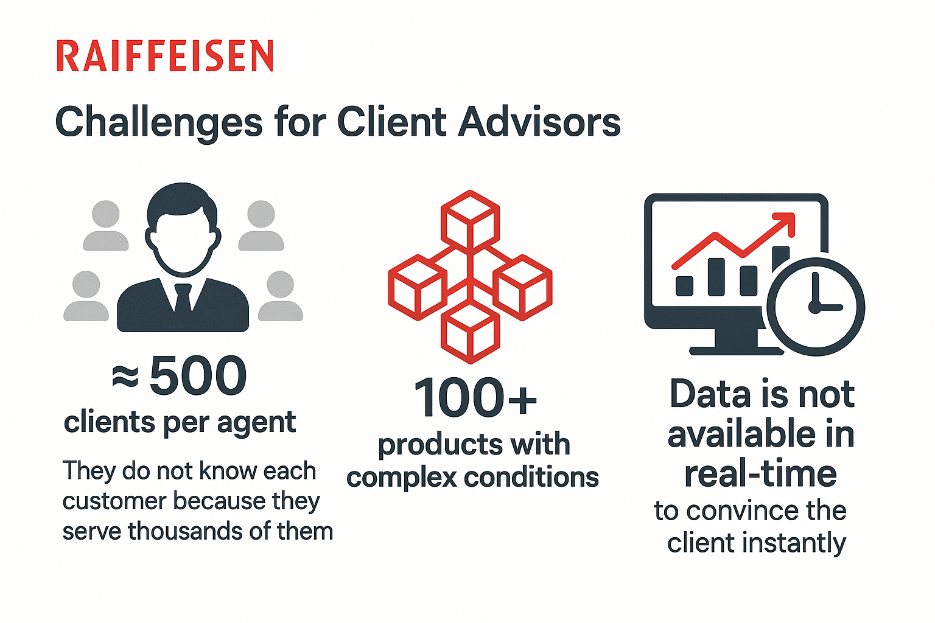
Client Advisors Challenges
500+ Clients per client advisor on average. Knowing each customer is impossible.
100+
Products with complex conditions
Delayed data insights
Data is not available in real-time to close the client instantly.
Client relationship
Client advice

Slide 3

Our solution: SmartAdvisor
SmartAdvisor helps client advisors build stronger client relationships and detect selling opportunities with real-time flashcards during the sales.

Slide 4


Our approach
Pre-meeting preparation:
Client information provides context and tips to bond
Suggested products based on client historical data and custom selling points
Support during the meeting:
Flashcards appear automatically during the meeting
Negotiation tips continuously provide support for sales team

Slide 5

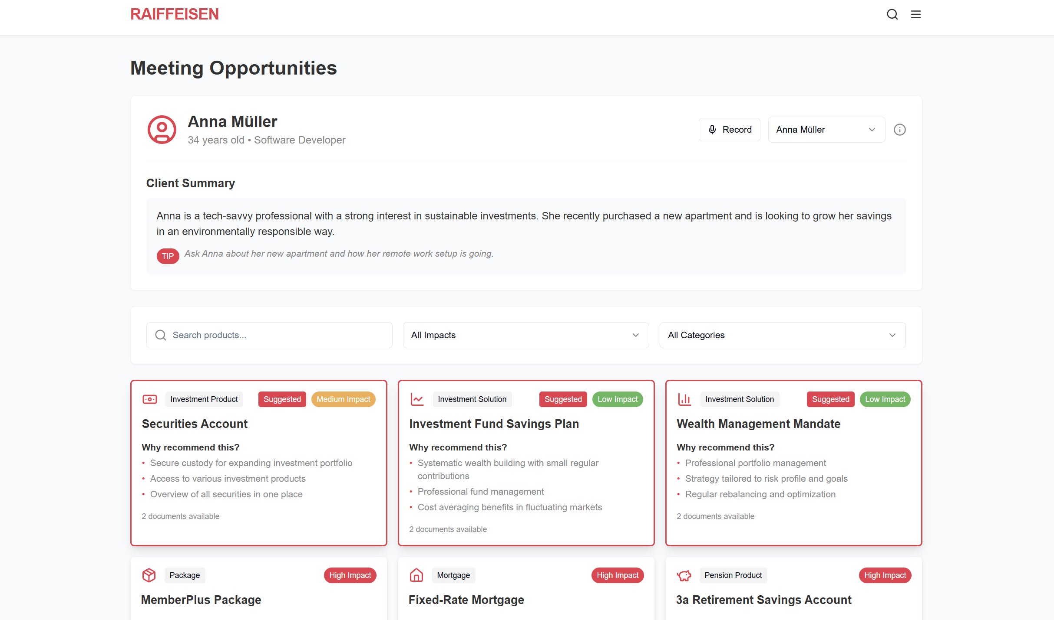
Demo

Slide 6
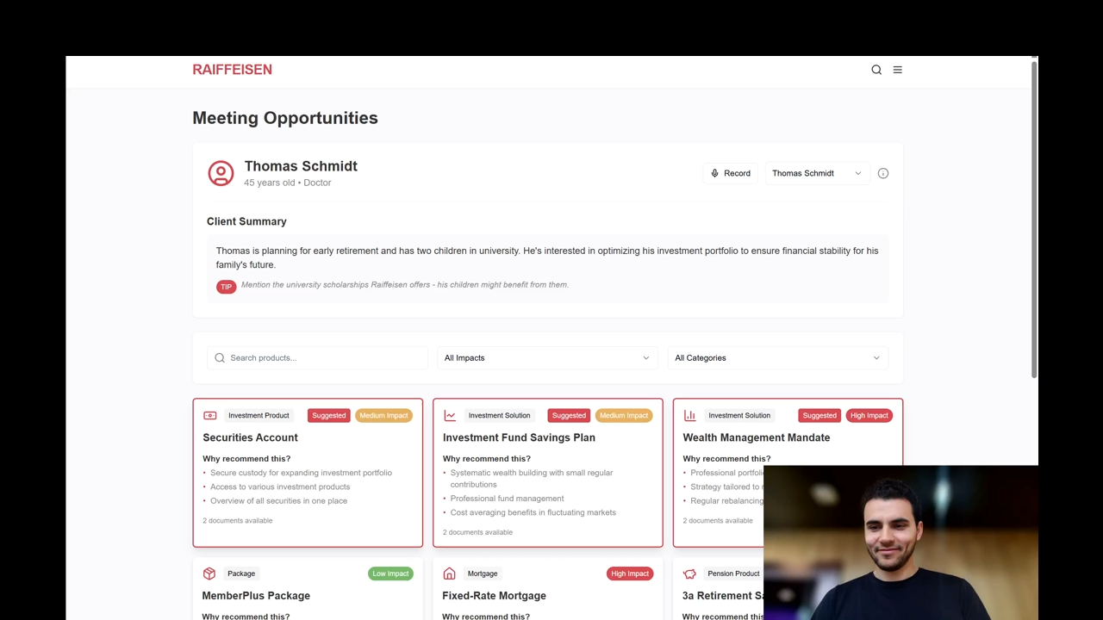

Slide 7
Thank you! Karim Zeid Noel Vase Riccardo De Luca Alessandro Feri Pierluigi Salmena

